Slide 1
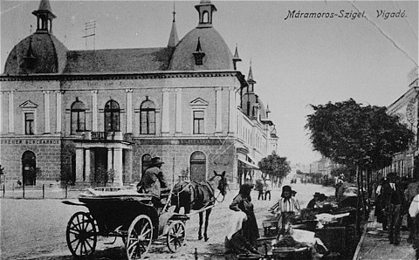
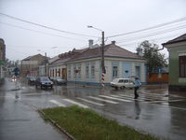
Night By Elie Wiesel
Pages 3-11
The Wiesels: Grocery Shop Owners and Keepers
Parents: Shlomo, Sarah,
Children : Hilda, Bea, Eliezer, Tzipora Lived in the Home Below Before and During the Majority of World War II
Prewar View of Sighet, Transylvania

Slide 2
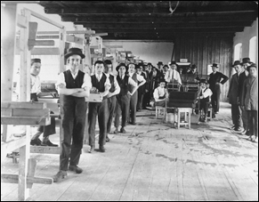
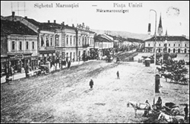
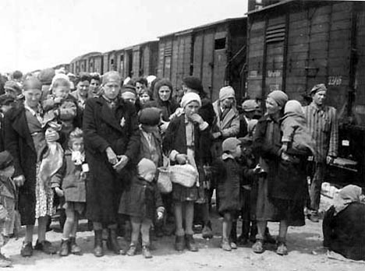
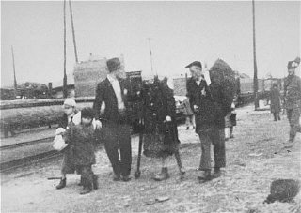
Before the Exile of the Jewish Peoples, Elie like Most Young Jewish Men Spent much of his Time Studying The Torah, Modern Hebrew, and Kabbalah
Jewish Community of Sighet, Transylvania
1941-42 : Elie’s Kabbalah Master and Local Vagrant: Moishe the Beadle and All Foreign Jews were Expelled from Sighet

Slide 3
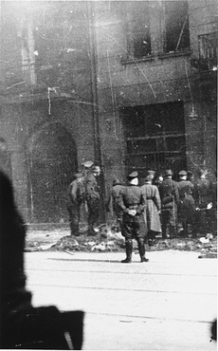
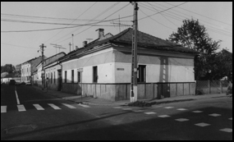
Moishe the Beadle Manages to Escape the Deportation Trains and Returns to Sighet With a Tale of Horror. Moishe Tried to Tell the Jewish Community That Jews Were Being Murdered After Leaving Their Communities. He tried To Warn the Others of What Was Really Happening, But the Jewish Community Refused to Listen. They Thought He Was Crazy.
Then in 1944 The Germans Invaded the Town of Sighet-Life Went On As Normal For A Short While.
“On the Seventh Day of Passover, the Curtain Finally Rose: The Germans Arrested The Leaders of The Jewish Community.”
“The Race Toward Death Had Begun.”
1944: New Laws and Edicts Were Enforced by Threat of Death. The Jewish Community was Exiled into Two Ghettos, The Wiesel Home Located in the Larger of the Two Ghettos Housed the Wiesel Family, and Other Relatives Before the Evacuation of All Jews From Sighet

